Slide 1
Benchmark Setup

Slide 2




Single-Threaded Benchmark
Setup Details
100000 Records
1 Batch Job
MAC M3 - 6 Cores / 16GB Memory (France)
5-Nodes Single Region Cluster (us-east-1)
m5d.2xlarge - 8vCPU, Memory 32GB, Disk GP3 200GB

Slide 3
Single-Threaded Benchmark
CRDB vs Managed Postgres, Db2 and Oracle
Batch Size | CRDB - 5-Nodes Single-Region Multi-AZ Cluster
 | Insert | Update | Delete | Mixed CRUD
100 | 415 | 412 | 441 | 378
1000 | 2250 | 2560 | 2419 | 2825
10000 | 21247 | 22137 | 22936 | 18685
100000 | 143625 | 138173 | 185398 | 169809
Batch Size | RDS PG |  |  |  | Cloud SQL PG
 | Insert | Update | Delete | Mixed CRUD | Insert | Update | Delete | Mixed CRUD
100 | 374 | 373 | 350 | 241 | 413 | 439 | 301 | 294
1000 | 1025 | 879 | 824 | 967 | 1290 | 1214 | 930 | 1112
10000 | 6944 | 6338 | 6487 | 6095 | 7497 | 7283 | 6653 | 7688
100000 | 87046 | 85041 | 76489 | 65857 | 89316 | 89583 | 87314 | 84960
 | -15% | -2% | -11% | -16% | -12% | 3% | 3% | 10%
DB2 |  |  |  | Oracle
Insert | Update | Delete | Mixed CRUD | Insert | Update | Delete | Mixed CRUD
320 | 356 | 319 | 320 | 12132 | 14424 | 13175 | 13244
1814 | 1917 | 1664 | 1415 | 118938 | 121854 | 118933 | 119908
15709 | 13521 | 12182 | 11045 | 1123956 | 1236454 | 1102764 | 1154391
129320 | 144333 | 127070 | 112096 | ∞ | ∞ | ∞ | ∞
-11% | 4% | -46% | -51% | 98% | 98% | 98% | 98%

Slide 4
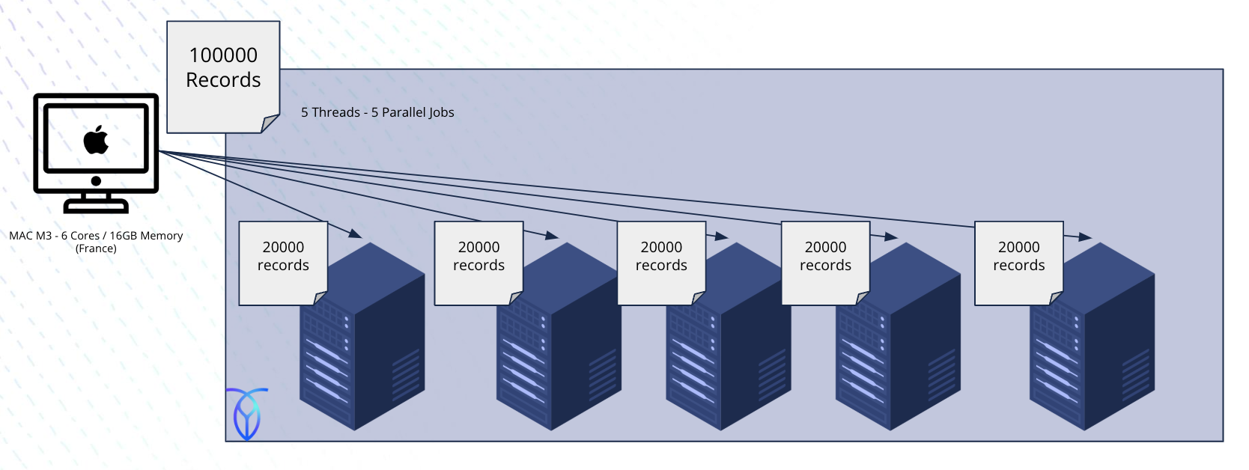
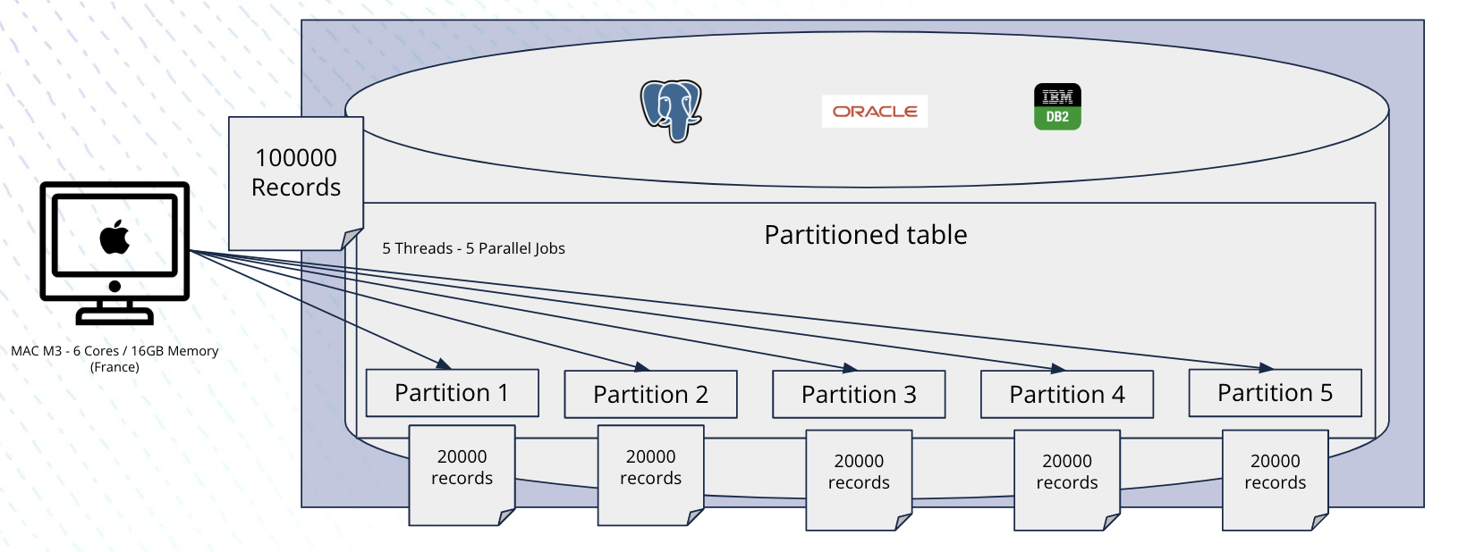
Batch Parallelization Benchmark
Setup Details
Batch input file is split based on database partition ranges
In CRDB: create as many job threads as nodes in the cluster
In other DBs: create as many job threads as partitions in the DB
For each thread:
Iterate over the chunk, execute the CRUD operations into the node/partition and collect metrics
Deactivate JDBC autocommit, and we explicitly commit once the batch is over
Add batch statements into a JDBC batch and execute them once the chunk is over
For CRDB, inserts/updates were optimized using rewriteBatchedInserts/rewriteBatchedUpdates parameters.
Cockroach DB v24.1.1 - 5-Nodes Single Region Cluster (us-east-1)
m5d.2xlarge - 8vCPU, Memory 32GB
Managed PostgreSQL 16 - EE (us-east-1) m5d.2xlarge - 8vCPU, Memory 32GB
Managed IBM DB2 13 - Performance (Gen 3) (us-east-1)
7.84 RU - 8vCPU, Memory 32GB
Managed Oracle 19 - EE (us-east-1) db.m5.2xlarge - 8vCPU, Memory 32GB

Slide 5
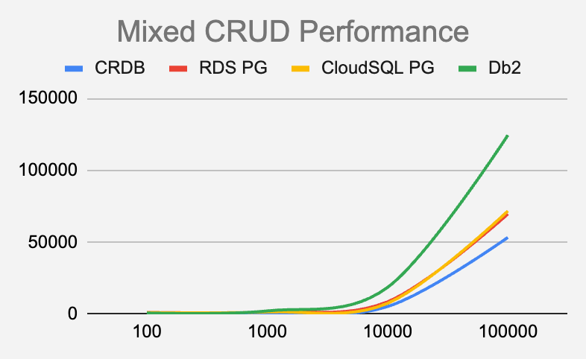
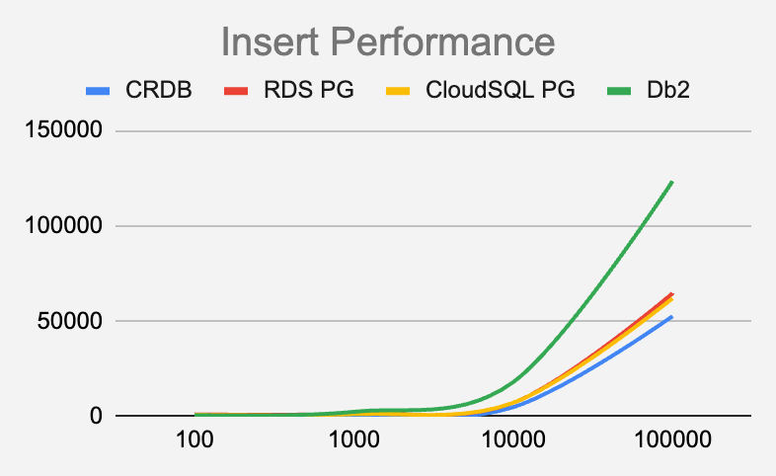
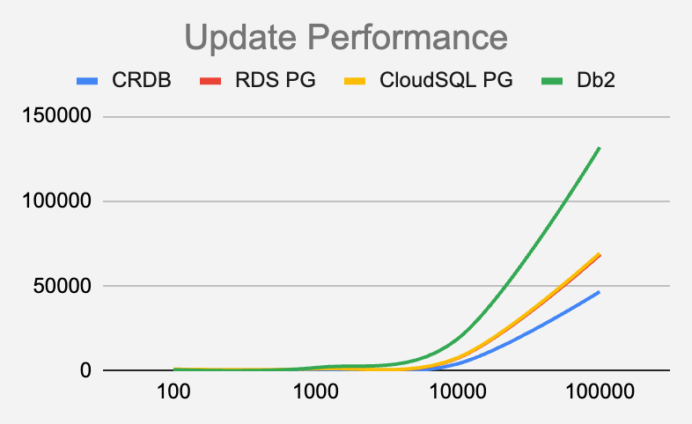

Batch Parallelization Benchmark
Performance Chart
For 1 Million Mixed CRUD Workload
CRDB is 24% faster than RDS Postgres
CRDB is 34% faster than CloudSQL Postgres
Job Execution Time (ms)
CRDB is 95% faster than Db2
Workload (# Records)
Job Execution Time (ms)
Job Execution Time (ms)
Job Execution Time (ms)
Workload (# Records)
Workload (# Records)
Workload (# Records)

Slide 6
Batch Parallelization Benchmark
Performance Observations
For a million record batch workload:
CRDB on average is 27% faster compared to managed Postgres in AWS RDS and GCP CloudSQL
CRDB on average is 95% faster compared to Db2 LUW
CRDB does not require any database partitioning work, the workload could be parallelized across the number of nodes available. Whereas traditional databases require manual partitioning and splitting the workload based on the partition ranges
CRDB performance gets better compared to traditional databases as the workload size increases [From 100K to 1M records]:
Average 6% additional improvement for managed Postgres
Over 40% additional improvement for Db2
Job Execution Time (ms)
Workload (# Records)

Slide 7
Batch Parallelization Benchmark
Performance Metrics
Batch Size | CRDB 5-Nodes Single-Region Multi-AZ Cluster
 | Insert | Update | Delete | Mixed CRUD
100 | 297 | 291 | 333 | 365
1000 | 698 | 743 | 750 | 731
100K | 4945 | 4266 | 4872 | 5316
1M | 52645 | 46753 | 55758 | 53402
Batch Size | RDS PG 5Range-Partitions (Multi-Threaded) |  |  |  | CloudSQL PG 5Range-Partitions (Multi-Threaded)
 | Insert | Update | Delete | Mixed CRUD | Insert | Update | Delete | Mixed CRUD
100 | 1184 | 1063 | 1224 | 1291 | 994 | 1117 | 934 | 1132
1000 | 1571 | 1410 | 1453 | 1642 | 1340 | 1434 | 1425 | 1594
10000 | 7230 | 7602 | 7170 | 8623 | 7237 | 7837 | 7115 | 7572
100K | 64654 | 68393 | 65397 | 69672 | 62042 | 69399 | 61291 | 71779
1M | 597261 | 619365 | 607462 | 648274 | 610385 | 640286 | 592012 | 683927
100K Recs CRDB is faster by | 19% | 32% | 15% | 23% | 15% | 33% | 9% | 26%
1M Recs CRDB is faster by | 24% | 33% | 19% | 24% | 26% | 29% | 24% | 34%
DB2 Partitioned (Multi-Threaded) |  |  |  | Oracle Partitioned (Multi-Threaded)
Insert | Update | Delete | Mixed CRUD | Insert | Update | Delete | Mixed CRUD
782 | 757 | 739 | 857 | 11610 | 11051 | 11215 | 11292
2541 | 2035 | 1859 | 2303 | 116033 | 117705 | 113268 | 115669
18068 | 18931 | 18114 | 18628 | 1102733 | 1135648 | 1107563 | 1115315
123468 | 131755 | 131251 | 124503 | NA | NA | NA | NA
1062054 | 1067512 | 1068815 | 1098733 | NA | NA | NA | NA
57% | 65% | 58% | 57%
95% | 96% | 95% | 95%

